Slide 1
MuleSoft CloudHub 2.0 Overview For MuleSoft Developers & Architects

Slide 2
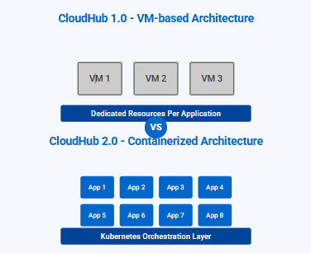
CloudHub 2.0: Basics and Next-Gen Architecture
What is CloudHub 2.0?
A fully managed, containerized integration Platform as a Service (iPaaS) for deploying APIs and integrations
Key Advantages
Global deployments across 12 regions for improved performance
Dynamic scaling to support elastic transaction volumes
Enhanced security with encrypted secrets, firewall controls, and restricted shell access
Kubernetes-based containerization for improved resource utilization
Private spaces with isolated networking and customizable security

Slide 3
CloudHub 2.0 vs CloudHub 1.0: Key Differences & Advantages
CloudHub 1.0
CloudHub 2.0
Architecture
VM-based with dedicated resources per application
Applications isolated in dedicated VMs
Fixed vertical scaling capabilities
Scalability
Manual scaling by changing worker size
Limited to 16 vCores per app
Regional deployment only
Security
Basic VPC isolation
Standard TLS configuration
Single security group management
Architecture
Kubernetes-based container platform
Microservices architecture with isolated containers
Improved resource utilization and density
Scalability
Dynamic horizontal scaling capabilities
Flexible resource allocation
Security
Enhanced encryption for secrets at rest & in transit
Granular firewall rules and network controls
Private spaces with complete network isolationlobal deployments across 12 regions

Slide 4
CloudHub 2.0 vs CloudHub 1.0: Key Differences & Advantages
CloudHub 1.0
CloudHub 2.0
Management
Runtime Manager for app management
Simple application names (globally unique)
Basic CloudWatch monitoring
Deployment
Support for Mule 3.x and 4.x runtimes
Fixed deployment strategy
Limited network configuration options
Management
Centralized observability dashboard
Application names can be reused across deployments
Advanced metrics and monitoring capabilities
Deployment
Support for Mule 4.3.x and later only
Zero-downtime deployments
Shared spaces and private spaces options

Slide 5
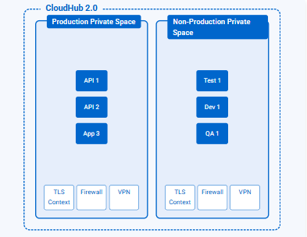
Private Space Concept & Isolation
What is a Private Space?
A virtual, private, and isolated area in CloudHub 2.0 for running your applications
Multiple private spaces can be created across different regions or environments
Security & Isolation Benefits
Network isolation with dedicated CIDR blocks and private connectivity
Granular access control with environment-specific permissions
Customizable firewall rules for inbound/outbound traffic control
Scalability Advantages
Containerized architecture allows efficient resource utilization
Independent scaling for applications within each private space

Slide 6
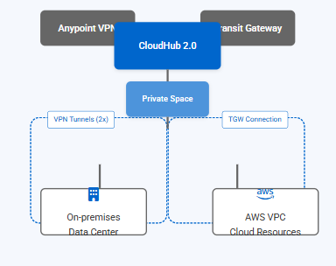
Connectivity: VPN & Transit Gateway Options
Connectivity Options
CloudHub 2.0 private spaces connect to your networks through VPN or Transit Gateway
VPN Connectivity
Anypoint VPN creates two tunnels for high availability with automatic failover
Supports static routing and dynamic BGP routing protocols
Transit Gateway (TGW)
AWS Transit Gateway enables consolidated connectivity between CloudHub 2.0, AWS VPCs, and on-premises networks
Preferred method for connecting to AWS resources and CloudHub 1.0 VPCs
Best Practices
Configure both VPN tunnels to ensure high availability during maintenance
Limit to 95 route table entries per private space, consolidate networks when possible

Slide 7
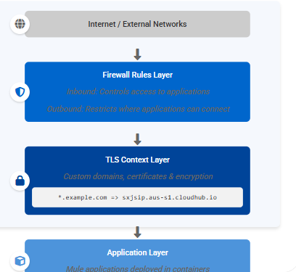
TLS Contexts & Firewall Rules
TLS Context Configuration
Define custom domains and certificates for apps deployed to private spaces
Securely store and manage certificates within Anypoint Platform
Support for wildcard domains for flexible subdomain deployments
Optional mutual TLS (mTLS) for client authentication
Firewall Rules
Inbound rules: Control external access to your applications (default: ports 80/443)
Outbound rules: Restrict where your applications can connect externally
Support for non-HTTP ports (30500-32500) for TCP traffic
Application-level egress rules for granular control

Slide 8
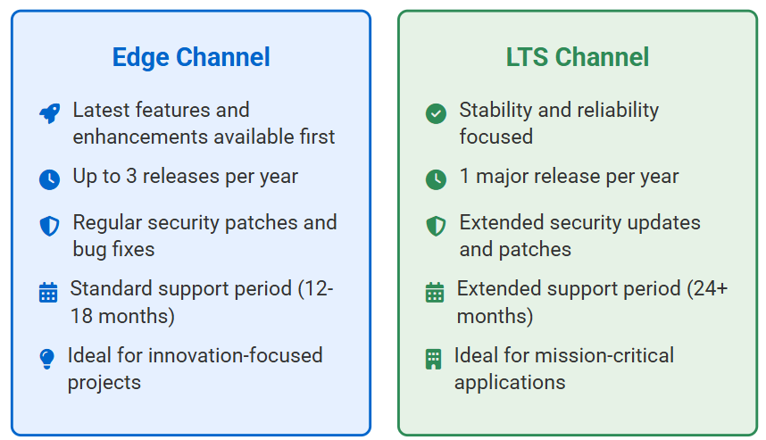
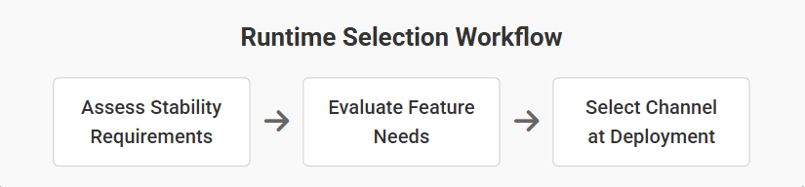
Supported Runtimes & Edge vs LTS
Supported Mule Runtimes
How to Choose Runtime Channel
Edge vs LTS Comparison
Runtime Version | Support Type | Supported in CloudHub 2.0
Mule 4.6.x | Current | ✓ Yes
Mule 4.5.x | LTS & Edge | ✓ Yes
Mule 4.4.x | LTS & Edge | ✓ Yes
Mule 4.3.x | LTS | ✓ Yes
Mule 3.x | Legacy | ✗ No
Both Edge and LTS channels available in all deployment models: CloudHub 2.0, Runtime Fabric, and standalone

Slide 9
Endpoint Configuration & Inbound Traffic
HTTP/HTTPS Endpoint Setup
CloudHub 2.0 supports HTTP/HTTPS endpoints only in apps deployed to private spaces (not shared spaces)
Applications can only listen on port 8081 for HTTP/HTTPS traffic
Each app can have multiple custom domain endpoints configured
Custom Domains
Upload custom certificates to create TLS contexts in private space settings
Configure CNAME records to point your domain to CloudHub 2.0 load balancer
Example:
*.example.com => sxjsip.aus-s1.cloudhub.io
Endpoint Access Types
Public DNS: app.sxjsip.aus-s1.cloudhub.io
Internal DNS: app.internal-sxjsip.aus-s1.cloudhub.io
Cluster local: app.envid.svc.cluster.local:8081

Slide 10
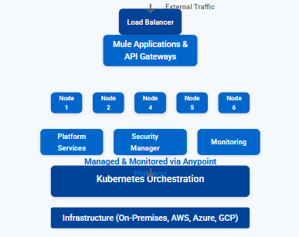
Runtime Fabric (RTF): Architecture & Overview
What is Runtime Fabric (RTF)?
A container service that automates deployment and orchestration of Mule applications and API gateways
Self-managed Kubernetes-based infrastructure that can be deployed on-premises or in any cloud
Key Components
Platform Orchestrator - Manages infrastructure resources, installation, upgrades
Cluster Manager - Handles application deployments, load balancing, scaling
Security Components - TLS, API management, secrets encryption
Monitoring Services - Metrics collection, logging, alerting
RTF Benefits
Isolation and enhanced data security for regulated industries
Fine-grained control over infrastructure and network configuration

Slide 11
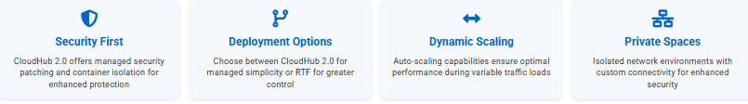
Monthly Patching & RTF Use Cases
Factor | CloudHub 2.0 | Runtime Fabric
Operational Overhead | Low (Fully Managed) | Medium (Self-Managed)
Control & Customization | Standard | High
Monthly Patching | Automatic | Self-Managed
Data Residency | Region-Based | Fully Customizable
Deployment Speed | Fastest | Varies by Setup
Monthly Runtime Patching
CloudHub 2.0 applies automatic runtime and OS security patches on a monthly cadence
Patches apply during maintenance windows with zero downtime (rolling updates)
Edge releases receive patches more frequently than LTS releases
RTF requires manual application of runtime patches following customer-defined schedule
Testing applications in lower environments before patching production is recommended

Slide 12
Best Practices
Configure firewall rules to restrict inbound/outbound traffic to only necessary endpoints
Create separate private spaces for production and non-production environments
Use internal DNS names for inter-application communication within private spaces
Implement mutual TLS for sensitive applications requiring enhanced security
Configure forward logs to Anypoint Monitoring or external services for visibility
Choose LTS runtime for stable production environments; Edge for newer features
Leverage dynamic scaling for applications with variable load requirements
Use Transit Gateway attachments for high-throughput connectivity needs
Deploy mission-critical applications with multiple replicas for high availability

